Slide 1
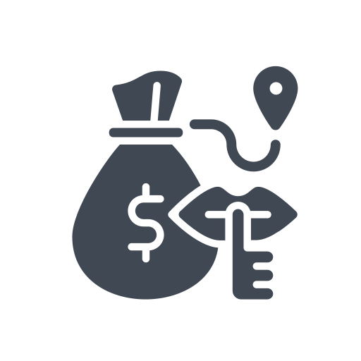
SeizeChain
An Approach to Secure the Seizure Procedure
Team 104_Not_Found
Notes:
Hi, everyone. We are team 104_not_found from BUET. In this presentation, we are proposing an approach to secure the seizure procedure. Since our system is assuring secure seizure by incorporating blockchain technology, we named it SeizeChain.

Slide 2
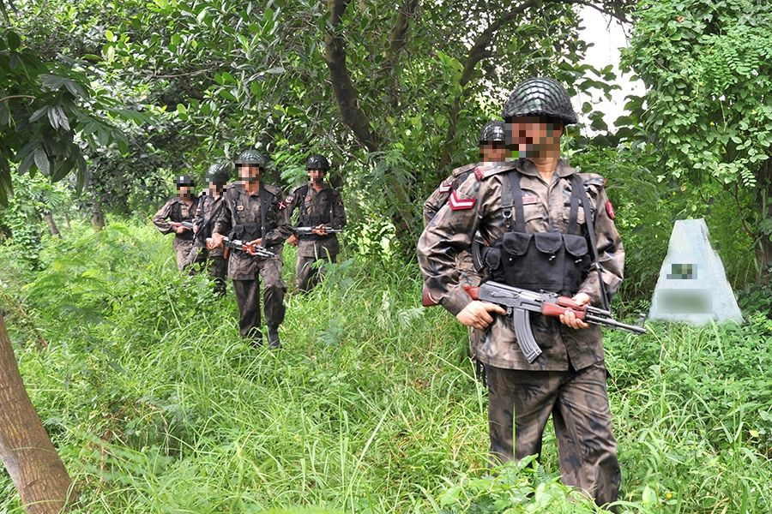
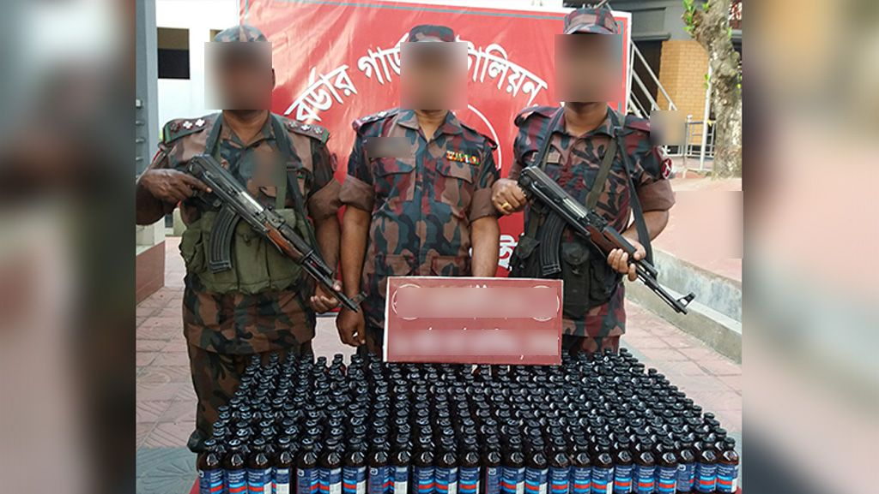
Current Scenario
BGB Sets out on patrol. Seize and possibly capture smugglers and hand them over to their sector commander. Based on the goods seized and whether anyone’s apprehended or not they are transferred and processed.
confiscated narcotics worth more than 2 billion BDT
In January 2022
Notes:
Smuggling is one of the major issues for any country in the current scenario. Bangladesh is a small country that is surrounded by India and Myanmar. So, we shared significant border areas with these two countries. In these areas, smuggling has been a major concern in the present scenario. BGB or other law enforcement officials seize goods from the border area regularly. In January 2022, BGB confiscated narcotics worth more than 2 billion BDT. But the whole process of managing these goods is still manual. We found some potential loopholes in this manual system through domain studies.

Slide 3


Current Seizure Procedure
Goods are seized by BGB patrol teams
01
02
Seized goods are Handed over to BGB sector commander
/
11
Handed over to the
customs
Handed over to the police
21
Goods are sold by arranging auctions
Store goods for a certain period of time
12
22
Deposit the money to national treasury
13
Demolish them in the presence of civil service officer
23
Notes:
Here, we demonstrated the current seizure procedure in short. click BGB seized goods in the border areaThey are handed over to BGB high officialsbased on the smuggled goods type there are two paths in general. if the Smuggle goods are cattle, money, or goldsThey are handed over to customsand Customs call auction and sell themFinally earned money has been deposited into the national treasury
Again, Smuggling goods can be drugsThey handed over to police with smugglersthey are stored for a certain timeFinally, drugs are demolished in the presence of civil service officer

Slide 4
Problems
#1
#2
#3
#4
Error prone record keeping system
Difficult to maintain manual records using pen and paper
Seized goods and their records easy to alter
Difficult to cross check records
Notes:
Manual record-keeping systems have some flaws.As, the whole system is manual, there is a high chance to generate error in record managementWhole procedure is managed by pen and paper, it is really difficult to track specific seizureThere is a high chance that the record can be tempered by an official who is correspondent to the systems.Since the system is manual, it is difficult to cross-check specific records.

Slide 5





Partners
Label seized goods
Digitally verify goods
Add record to the system
End the life cycle of a good
after it is demolished
BGB
Digitally verify goods
Magistrate
Maintain auction data
Customs Officers
Digitally verify goods
Monitor seized goods
Keep criminal records
Monitor auction money
Bangladesh Police
Regulator
Notes:
In the whole seizing procedure, there are 5 types of partners. BGB abbreviated from border guard of Bangladesh label seized goods and add the record to the system.Bangladesh police digitally verify the records and make charge sheet for smugglersCustoms officers receive goods. They have the authority to verify goods and maintain auctions for selling goodsMagistrates are present during the time of drug demolishment. They play vital role in this part of the system.Regulatory bodies such as Bangladesh bank monitor the whole seizing procedure and auction money.

Slide 6



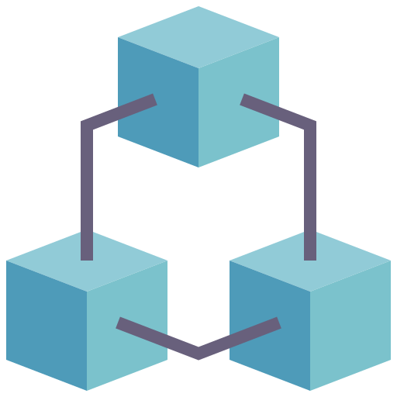

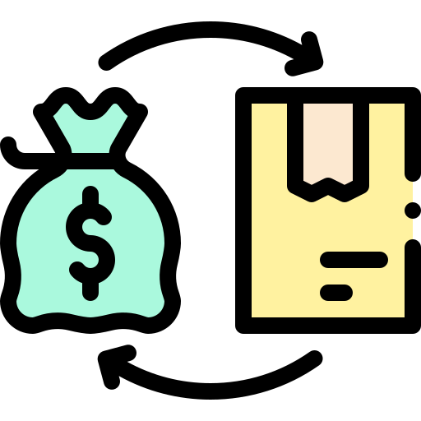














Our Solution
Notes:
As the current system has some flaws, we come up with a solution that ensures the whole procedure is secured.After the BGB patrol team seizes things, they will record the details of the seized goods in the ledger.A smartphone application and a portable printer will be provided. The app will be used to generate a QR code and record all the information. The QR code will be attached to the seized goods. The QR code will contain all the information about that consignment.The seized goods will then be transported to the sectors where they will undergo cross-checking and be stored. Finally, the sector commander adds entries for any discrepancies and sends the drugs to the police. Police inspect the goods and send a portion of drugs to court. Then, with the consensus of corresponding authorities and magistrate, the goods are decided for demolishmentThen, the demolishment happens with the presence of themIf the seized good has some monetary value then BGB officials handed over them to customs. They receive them and report discrepancies if any. After that, they arrange an auction and sell them. Finally, earned money is deposited into National Treasury

Slide 7



Why Permissioned Blockchain
Immutability
Separate Channel
Traceability
Notes:
In this system, we used permissioned blockchain for three reasons. As our major goal is to protect data from mutation. So, blockchain is a must. It ensures the immutability of the recordsAccording to the previous discussion, you have seen that the partners or organizations may vary depending on the seized goods type. So, we need a separate channel for different types of goods. This is one of the main reasons behind choosing of using permissioned blockchain.Finally, all records are added to the system with the consensus of the organization members. So, it helps to ensure actual traces of the records are not tempered.

Slide 8

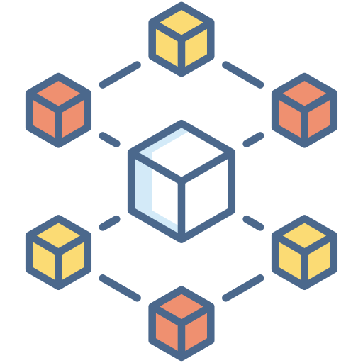











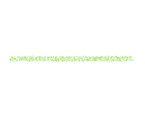

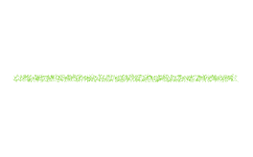










Architecture
Notes:
From the top view of our system architecture, there can be two types of users. One may come from mobile and another may come from a website. So, users request access to a particular ledger for adding or updating data to the API server. API server receives a request from the client and requests for access to the blockchain. Blockchain decides the validity of the request based on access to a specific channel and ledger. Finally, the blockchain responds to API server with data if the request was valid. And the API server responds to the client. This is how the whole system works.

Slide 9


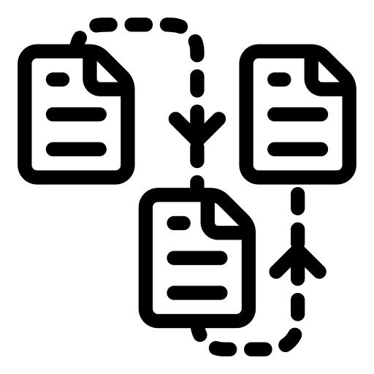








Blockchain Inside Workflow
Bangladesh Bank
BGB
Orderer
Kafka
Customs
Police
Magistrate
Notes:
Now, we will know more about blockchain inside workflow. Here, we used a very popular permissioned blockchain framework, Hyperledger Fabric. According to the previous discussions, there are 5 types of partners in the systems.#
For the convenience of our discussion, we consider partners as the organization and each individual of an organization counts as a peer. Here, we will demonstrate how a transaction is being processed in the systems.#
Suppose, one of the BGB members or peers requests a transaction to orderer.
Orderer is the central authority in hyperledger fabric blockchain who is responsible for managing the transection throughout the channel.#
Orderer keeps the transaction data to channel ledger by validating with other organization peers ledger data.##
Then, the updated ledger data is broadcasted to all organizations' anchor peers by using kafka messaging system given that they are in the same channel. #
The other two organizations will not get data from kafka cluster because they are not part of the system.#
Be noted that here we used kafka cluster as a messaging system which makes the system stable and reduce the chance of failure. #

Slide 10
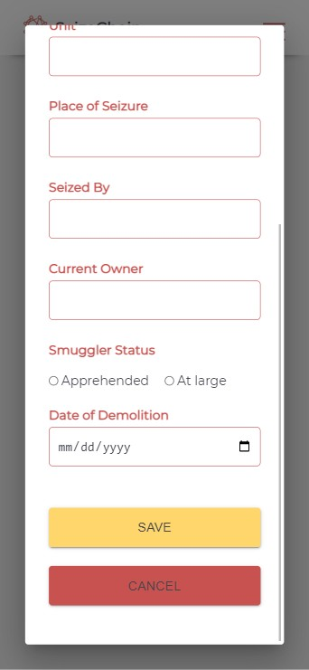
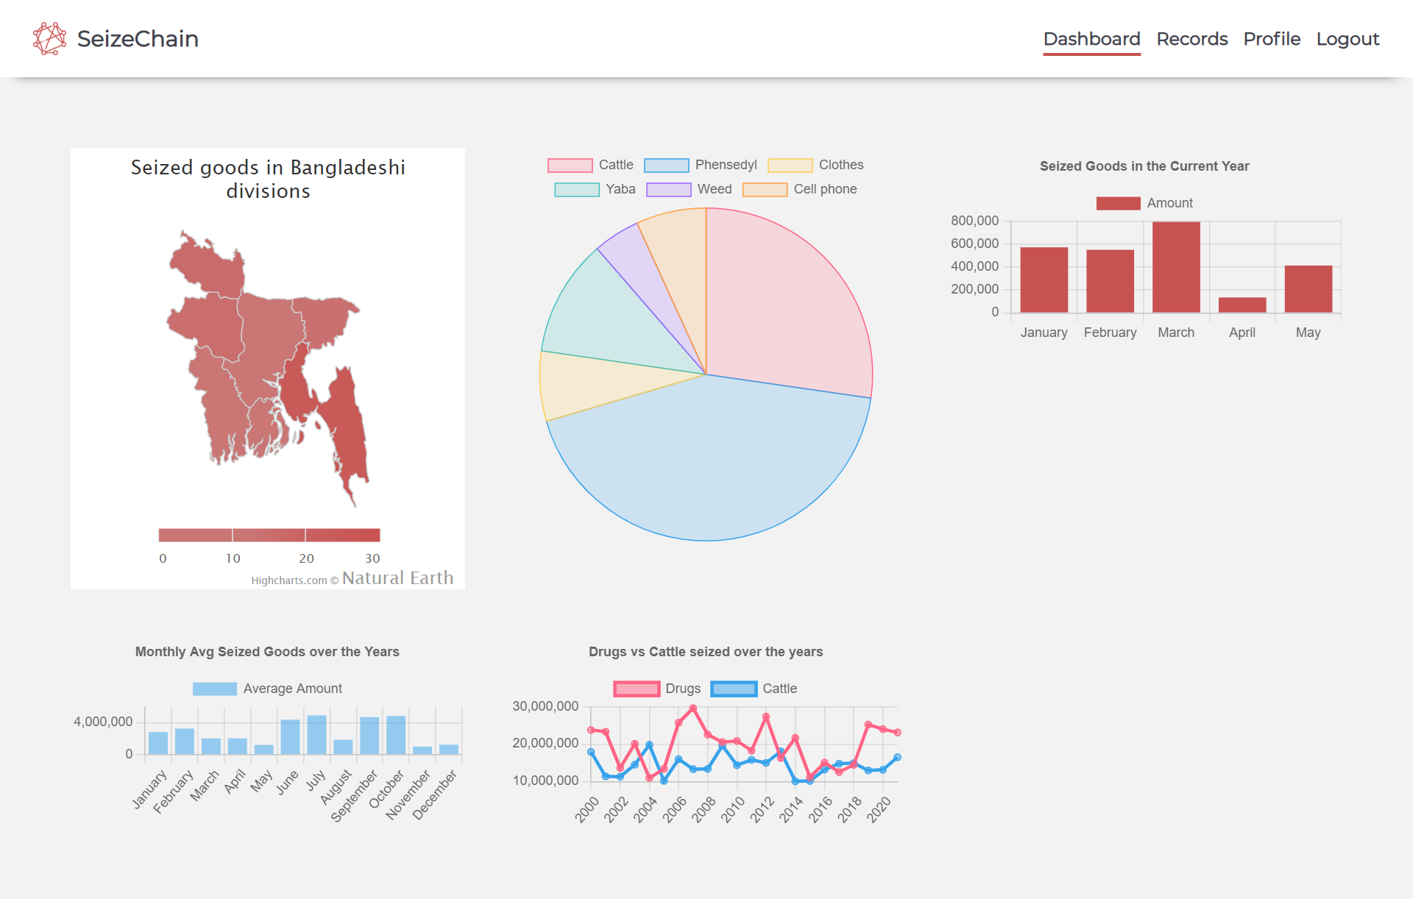
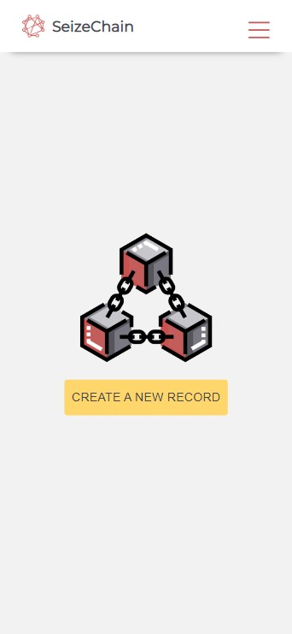
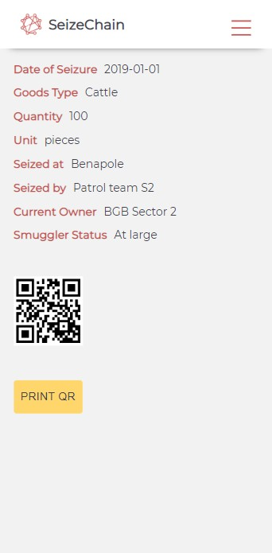
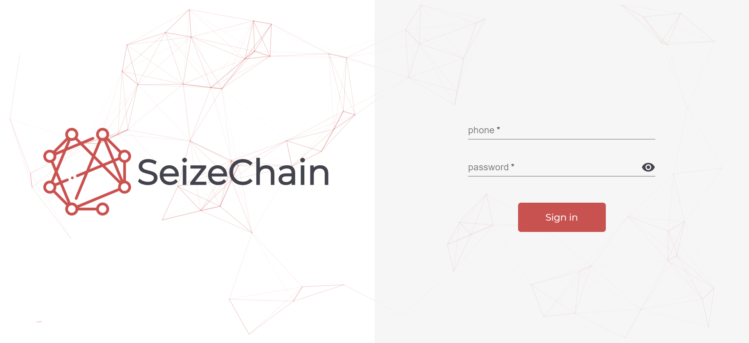
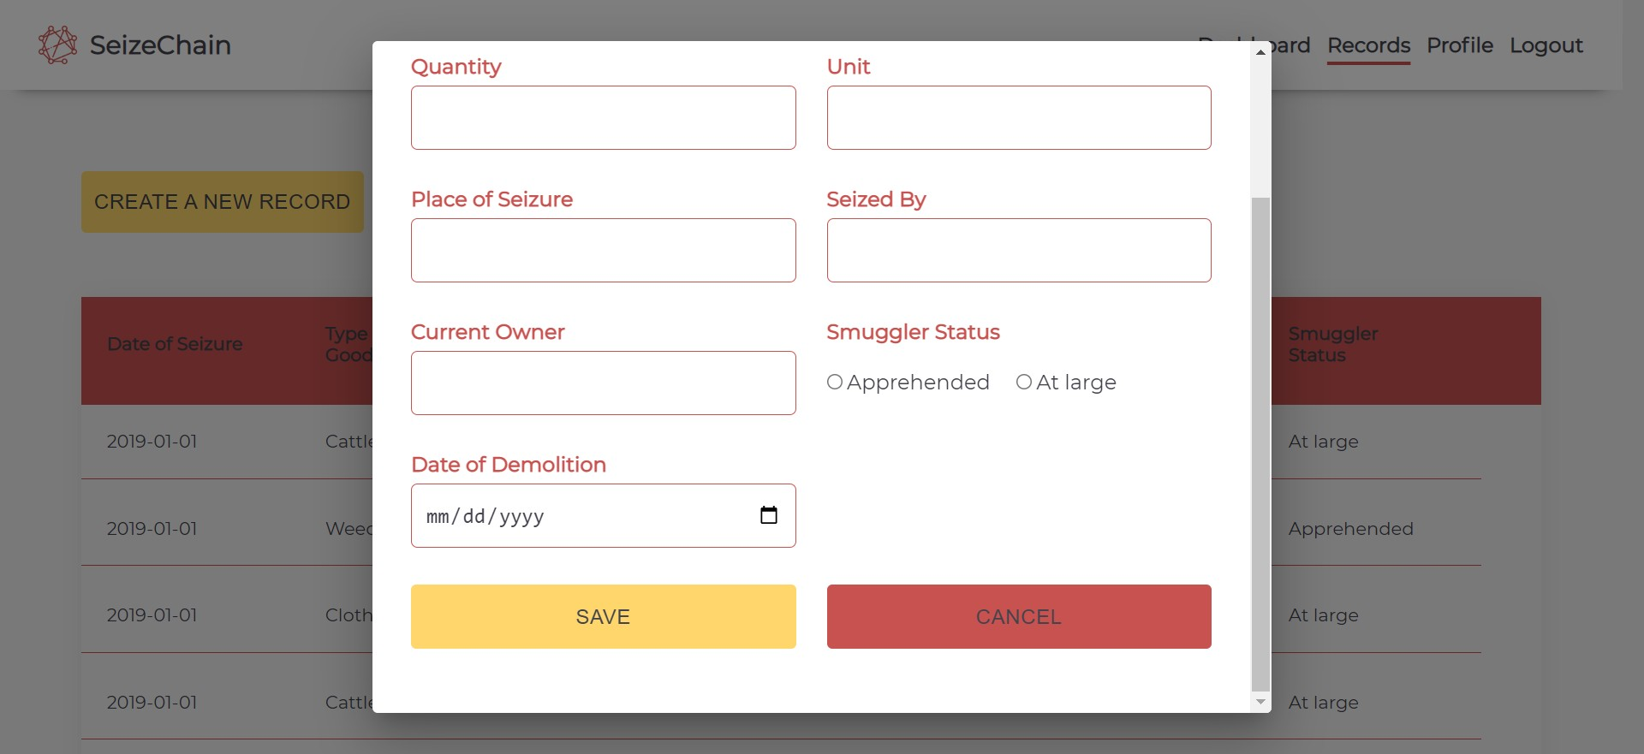
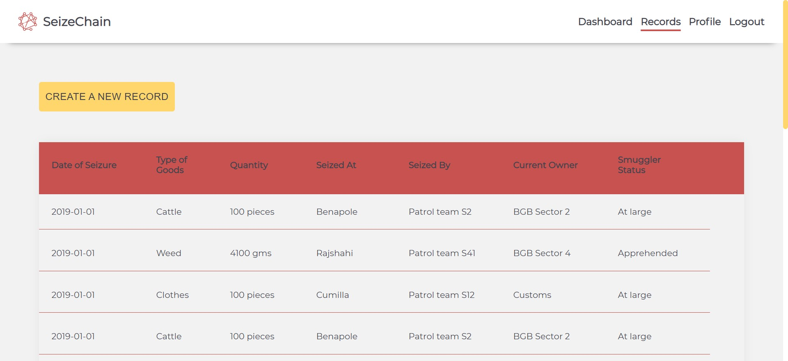
Application Overview
01
Entrance to Application
02
Analytical Data on Seizure
03
Add Genesis Block to system
04
Add Data by Patrol party
05
Generate QR
06
View records
Notes:
Now, we will briefly discuss the SeizeChain Application ##
By giving a phone number and password, a peer of an organization can log in to the system. Based on their role, their sets of action will be different. ####
After logging into the dashboard, he will see some analytics on which parts of our country are smuggling prone. A pie chart will represent the percentage of smuggled goods. The bar charts will show the month-wise analytics. These insights will give the current scenario of the border which helps the higher authority to decide on which parts of the border need more BGB members or not. ####
In the record module, BGB patrol members can add smuggle goods info as a genesis block to the system by giving required data. BGB patrol are the initial party in the system. So, they need to have portable entry system. So, we have app version of this application ###
BGB patrol party can add data from mobile app#
For adding data, they have to click on create new record##
Then, have to fill out the form and hit on save button####
After saving the data, system will create a QR code for the smuggled goods which will be used for further verification by high officials####
Finally, there is a table view for all records and their trace. #

Slide 11




Risk Analysis
Increase corruption among patrol parties
Partners denying to use the system
Older officers facing difficulties using the system
Costing overhead
Notes:
There are still some risk factors. #
As genesis block are added by patrol parties, there is a chance that they insert the wrong amount by getting corrupted. This limitation exists in any blockchain-based systems.#
The system will be fully digital and have to interact with android or webapp. So, there is a high chance that old officers will find the system difficult.#
Some partners may not agree to use the systems.#
For making this system workable, there will be needed to ensure that all members of each organization have smartphone or pc.#

Slide 12



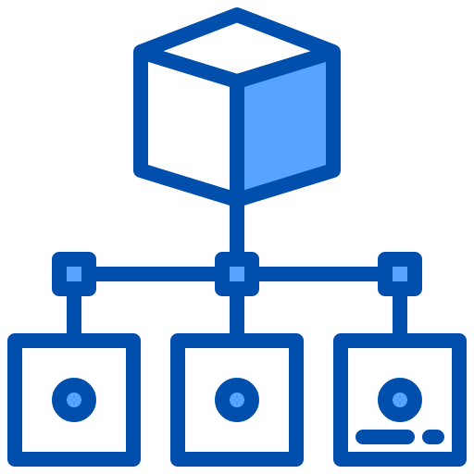
Action Plan
Improvement of the System
Conducting
surveys
Training of the partners
Deployment of the system
Notes:
We set some action plans for making this system feasible#
At the very beginning, we have to deploy the systems in a distributed cloud.#
Then need to train the partners to habituate to the systems.#
Also, need to survey in specific time intervals#
By getting the survey data, we have to improve the systems with an agile approach. #

Slide 13
Business Analysis
Corruption resistant
Genesis block information can be tempered
Strength
Weekness
S
W
O
T
Can be used for other purposes with slight modifications
Data can get manipulated if majority indulges in corruption
Opportunities
Threats
Notes:
Here is the business analysis of our systems. #
As data are immutable, it will make the system corruption resistant. It is counted as a Strength of the system#
Genesis block information can be tempered. So, it is considered as weakness. #
By doing slide modification, we can make other govt institutes corruption-proof. It is taken as opportunities #
If the majority gives a false vote, that will manipulate the whole system data. So, it is counted as a threat. #
Thanks for your patience

Slide 14
Thank you
Notes:
Thanks for your patience.

